Slide 1
Why RAID
Performance limitation of disk drive
An individual drive has a certain life expectancy
Measured in MTBF (Mean Time Between Failure)
The more the number of HDDs in a storage array, the larger the probability for disk failure. For example:
If the MTBF of a drive is 750,000 hours, and there are 100 drives in the array, then the MTBF of the array becomes 750,000 / 100, or 7,500 hours
RAID was introduced to mitigate this problem
RAID provides:
Increase capacity
Higher availability
Increased performance

Slide 2
Objectives
After completing this chapter, you will be able to:
Describe what is RAID and the needs it addresses
Describe the concepts upon which RAID is built
Define and compare RAID levels
Recommend the use of the common RAID levels based on performance and availability considerations
Explain factors impacting disk drive performance

Slide 3
Definitions
Strip : a predefined number of contiguously addressable disk blocks
Stripe : The set of aligned strips that spans across all the disks within the RAID set
Strip width : (also called stripe depth) describes the number of blocks in a strip and is the maximum amount of data that can be written to or read from a single disk in the set
Stripe width : Stripe size is a multiple of strip size by the number of data disks in the RAID set.

Slide 4
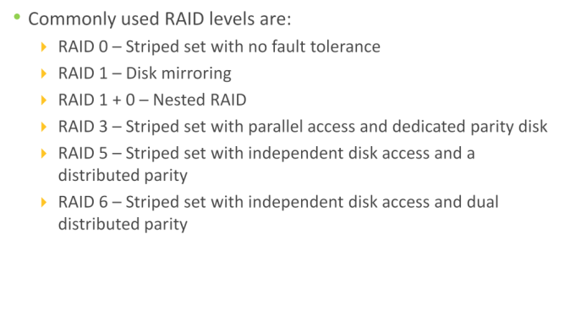
Raid Levels

Slide 5
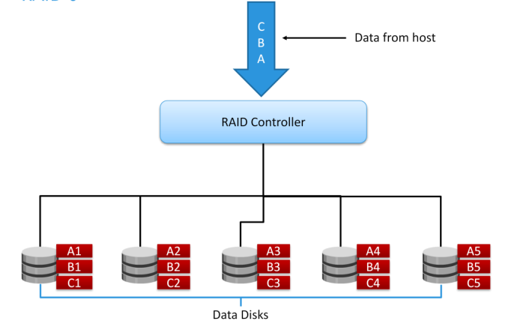
RAID 0

Slide 6
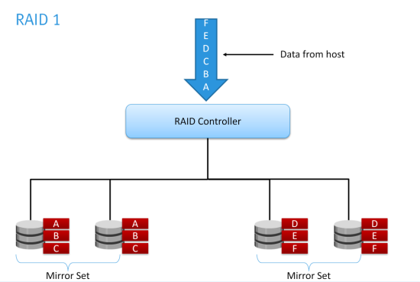
RAID 1

Slide 7
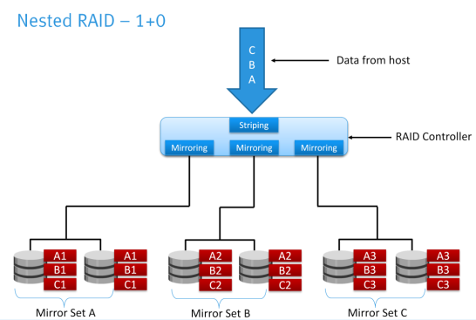
Nested - 0+1

Slide 8
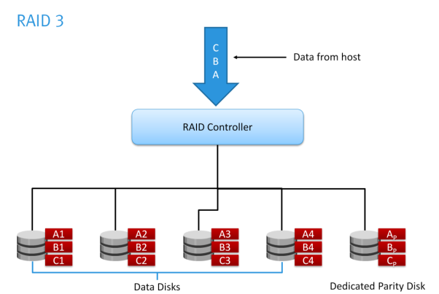
RAID 3

Slide 9
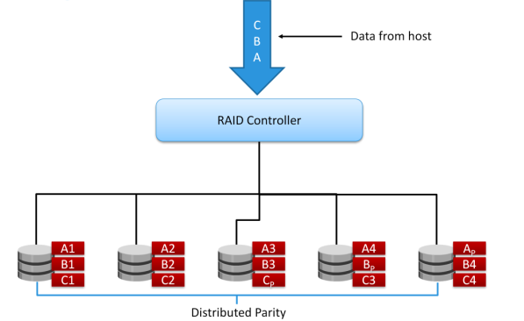
RAID 5

Slide 10
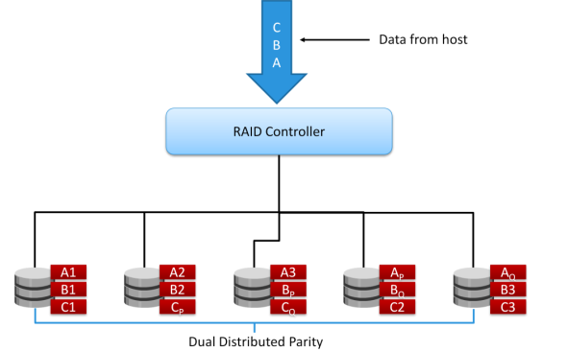
RAID 6

Slide 11
Summary
RAID levels

Slide 12
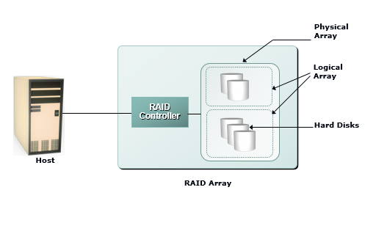
RAID Array Components

Slide 13
Raid Techniques
Three key techniques for Raid :
Striping
Mirroring
Parity

Slide 14
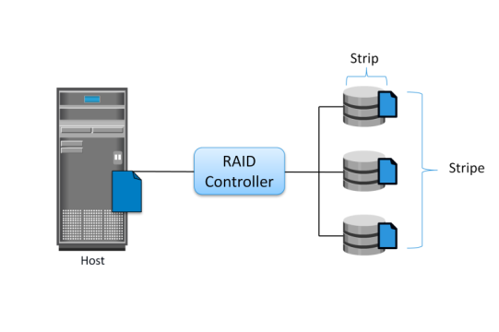
Raid Technique : Striping

Slide 15
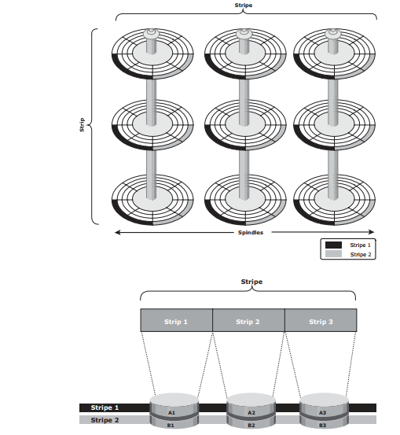

Slide 16
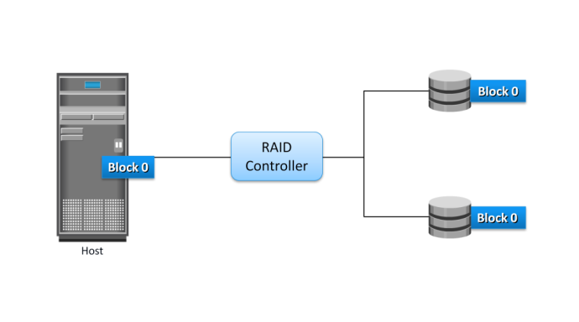
Raid Technique : Mirroring

Slide 17
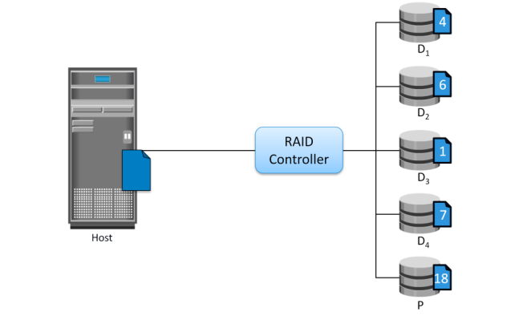
Raid Technique : Parity

Slide 18
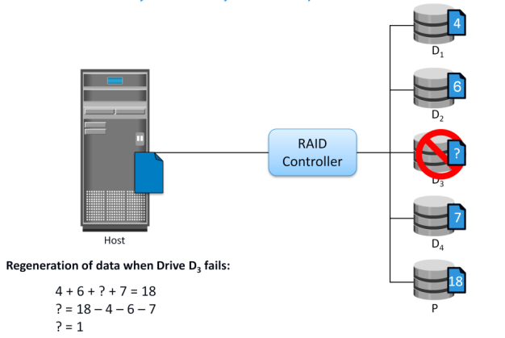
Data Recovery in Parity Technique

Slide 19
Summary
Raid Implementation
Raid Components
Raid Techniques

